Slide 1
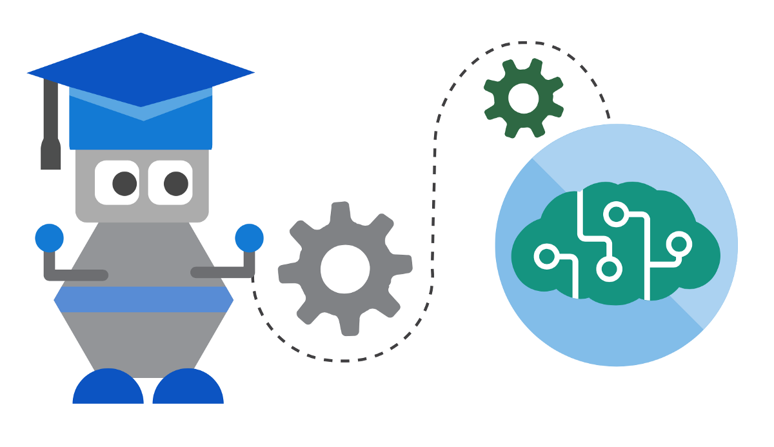
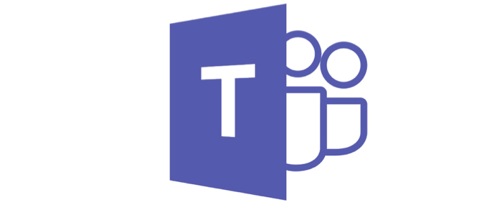
Building Bots for Microsoft Teams The hub for Teamwork in Office365

Slide 2




About Me..
Microsoft Certified Technology Specialist
C# Corner MVP, Author & Speaker
SharePoint Developer, QuadraSystems
Specialized on Office365, Dynamics CRM & Power BI
Jayanthi P
@JayanthiP
jayanthimcts@gmail.com

Slide 3
Agenda
Overview of Microsoft Teams
01
Microsoft Teams App
02
Bots –What? Why?
03
Bot Framework
04
Advanced Teams Bot Capabilities
05
Deploying Bots to Microsoft Teams
06
Demo
07

Slide 4
Before We Begin. Lets have a small talk on Digital Transformation

Slide 5
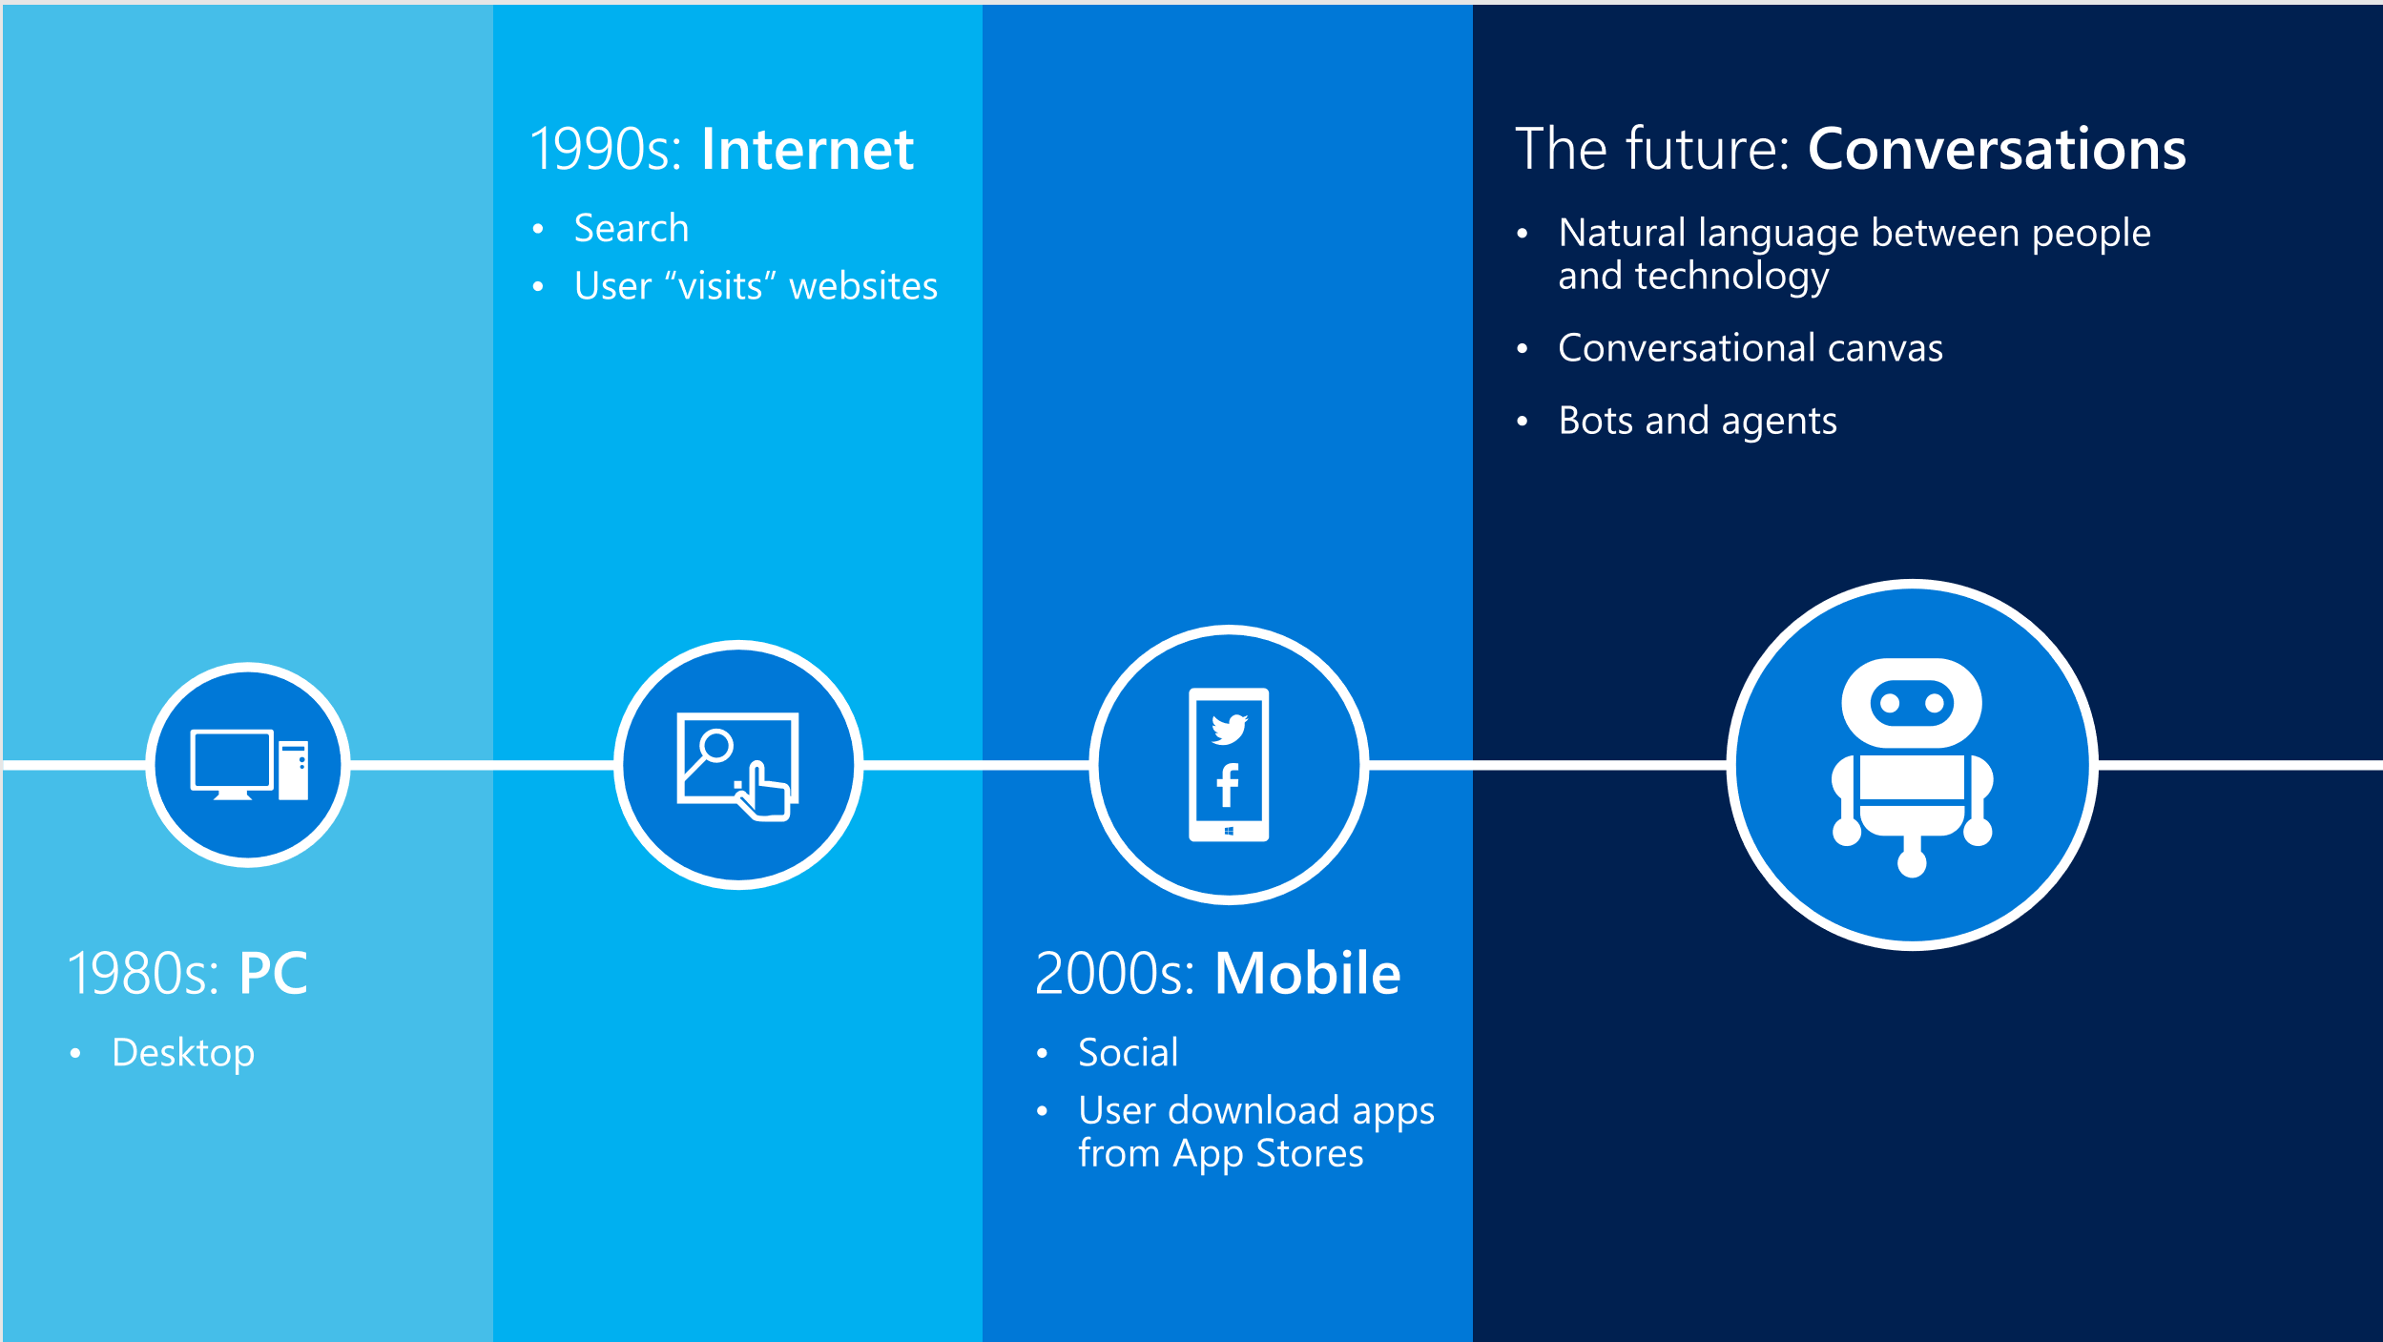

Slide 6
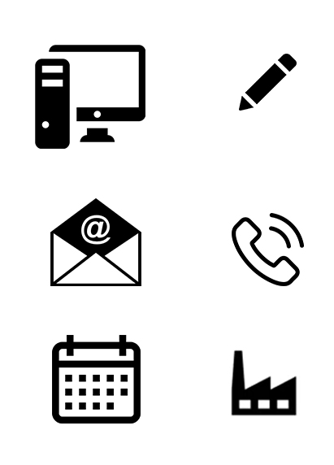
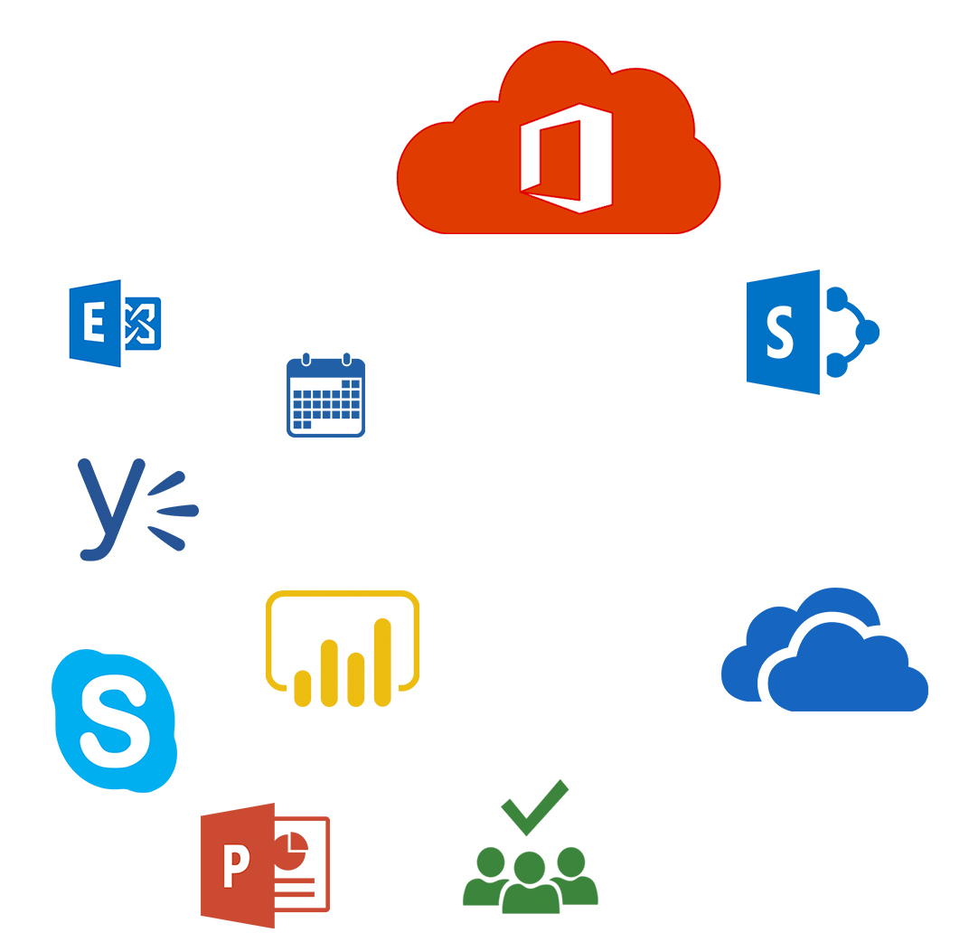
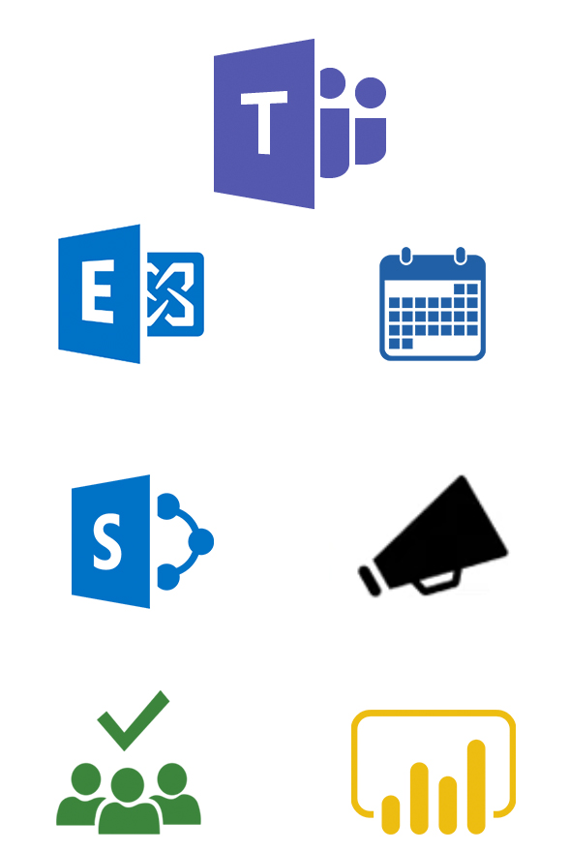
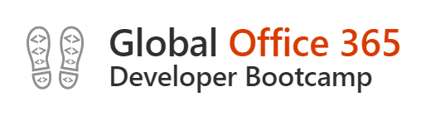
Collaboration Journey
Old
New
Modern
Notes:
Old- Customers had to use external apps like skype for business, files server
Control – admin to user
Data – structured to adhoc
Access – Linear to Parallel

Slide 7
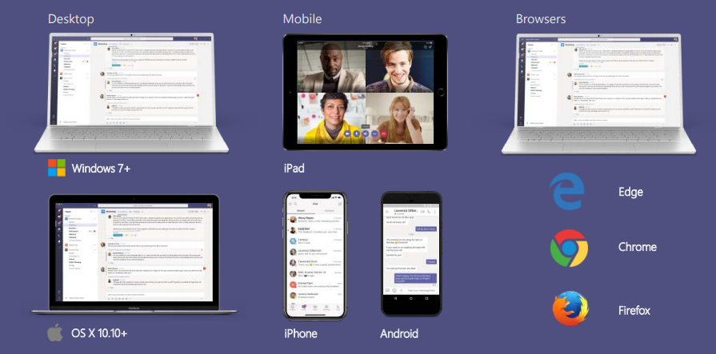
Cross Platform Presence –Teams where you want it

Slide 8
Why build apps on Microsoft Teams
Effortless Discovery
Build once, use Everywhere
Choose the audience for your App
Rich App Platform
Conversations comes free

Slide 9
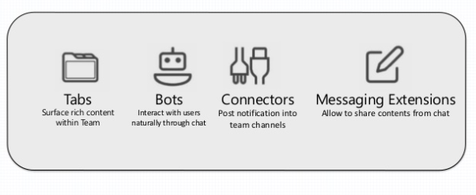
Microsoft Teams App

Slide 10
Bots – What? Why?
Chat bots are services that people interact with through conversation and messaging.
For Business
For Developers
For Users
Increased reach to customers
More Capable bots within less time
Choose your Channel
High Quality of bots but reduced cost of Development
Easy Integration
Human Language Interaction

Slide 11



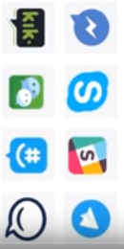




What is Bot Framework?
Bot Connector Service
Chat Bot API
Bot Builder SDK
Other Services

Slide 12

Advanced Teams Bot capabilities
Teams-Bot-extensions
Respond to events
Updating messages/cards
Dialogs, prompts and menus
Demo

Slide 13



Deploying Bots to Microsoft Teams
Design a great bot
Be responsive – respond to messages and events
Recognize and respond to questions and non-questions
Have a personality
Develop your bot
Bot Builder SDK for .NET
Bot Builder SDK for Node.js
Register and deploy your bot
Get a Bot ID and App ID/Secret and configure bot
Make sure bot is reachable from the internet
Enable analytics

Slide 14

Lets Get into Action

Slide 15
Prerequisites
Sign up for a free trial Azure Subscription
https://azure.microsoft.com/en-us/free/
Visual Studio 2015 or higher
Bot Builder SDK V4 Template
Bot Emulator
https://github.com/Microsoft/BotFramework-Emulator/releases
Microsoft Teams
https://teams.microsoft.com/downloads

Slide 16
Demo
Create a Bot Locally with the Bot Builder SDK V4 and Testing with Emulator
Building Intelligent Bot using QnA Maker and Azure Bot Service
Bot Integration with Microsoft Teams
Advanced Teams Bot Capabilities
Cards
Dialogs, Prompts and Menus
Teams-Bot-extensions
Respond to events

Slide 17

☺
THANK YOU

